Slide 1
_________________________________________________________________________
C&S Department Management Coaching Policy for payment of expenses

Slide 2
Contents
Section Page
1. Introduction 3
2. Coaching Expenses Policy 2005 4
3. Coaching Expenses Criteria Policy Supplement 2008 5
4. Compliance 6
5. Declaration 7
6. Appendices 6

Slide 3
Section 1 –Background
Introduction
UL Student Life is one of the few Students’ Unions in the country that receives its portion of Capitation directly to administer itself (approx. €100 per person). 50% of this funding is used to support student Clubs & Societies in the delivery of their voluntary activities.
In terms of student governance in its simplest form, the Clubs & Societies Council is a democratically structured forum organised for the Committee representatives of all Clubs and Societies to meet at least four times per semester to offer their views on the improvement and development of Clubs & Societies (C&S) to the Clubs & Societies Executive (CSE). They may also voice their concerns or grievances with any aspect of the administration of Clubs & Societies on campus. It is also the forum of approval by way of a vote for the annual budget, finances of C&S, policies (see slides 4 & 5), rules and regulations for the improvement of Clubs and Societies administration. Only those Clubs and Societies that have achieved full recognition status are entitled to vote, it does not extend to those on a 15-week trial period.
At Clubs & Society Council, the finances are available for discussion and approval sought by council members to maintain the practise of 100% transparency on all C&S funding. All 700+ C&S committee members receive budget allocation information via email annually.
UL Student Life as a company limited by guarantee has legal and financial compliance responsibilities which apply to its clubs and societies department.

Slide 4
Section 2 –Coaching Expenses Policy 2005
Submit Coaching credentials of coach in order to validate the request for coaching expenses and the cost associated with these services.
The credentials would require a letter/copy of the agreement with the club regarding the expenses and the experience of the coach in question and any relevant coaching qualifications from the governing body. (This can also apply to societies i.e. in terms of the stage manager or lighting expertise for the drama society).

Slide 5
Section 3 –Coaching Expenses Criteria Policy Supplement 2007
For the purposes of C&S, budget submissions all clubs will be entitled to a budget for training coaches. Not all teams within a club are automatically entitled to coaching fees, and only the elite teams receives support. It is the responsibility of the club to show that they have an elite team, in the case of multiple teams. The SL C&S executive will use the following criteria in their decision:
1. An elite team should compete at a national/international level in a competition deemed to be of an exceptionally high level as per their governing body.
Normally only two elite teams (one men’s and one women's team) can exist in any one club (unless the club is active in more than one discipline).
In addition, those clubs performing at standards for which professional coaching and training services beyond the capacity of the club members are justified can request coaching and training expenses in their budget submission. Coaching fees are subject to the following conditions
1. The maximum fee allowed per training session is set at € 75 OR the total amount of coaching fees in one year must not exceed €4500

Slide 6
Section 4 –Compliance
UL Student Life’s Clubs & Sports Department policy to pay suppliers in respect of all valid invoices within (a maximum 30 days) of receipt of invoice.
However, where relevant, UL Student Life C&S will continue to pay suppliers in line with contractual arrangements, some of which may fall outside the scope of the (30 days) noted above
As a public sector organisation, UL Student Life C&S is required to comply with the Department of Finance Circular 43/2006 in relation to the provision of a current valid Tax Clearance Certificate by suppliers. A Tax Clearance Certificate (or Tax Clearance Access Number) is required by suppliers who engage in transactions with UL Student Life C&S in excess of €5,000 (including VAT) in a twelve-month period.

Slide 7
Section 5 –Declaration
Declaration:
I acknowledge that I have received a copy of and understand the contents of UL Wolves Coaching policy for payment of expenses policy.
Name: ________________________
Club/Society:__________________
Date: _______________________

Slide 8
Section 6 –Appendices
Appendices Page
6.1. Revenue Registration 9
6.2. Apply for a Tax Clearance No. 14
6.3. Valid Invoice 16

Slide 9
Section 6.1 –Revenue Registration
How to register for tax as a sole trader
Before you register for tax, you must have a Personal Public Service Number (PPSN).
Your Tax Reference Number (TRN) will be the same as your PPSN. Your PPSN does not become your TRN until you register for tax.
eRegistration
You can manage your registrations through Revenue's eRegistration service.
Access the service:
in myAccount (if you are registering for Income Tax (IT) only)
using Revenue Online Service (ROS).
If you are not eligible for eRegistration, then you must complete a Form TR1, which can be used to register for IT ( Copy of TR1 in next page)

Slide 10
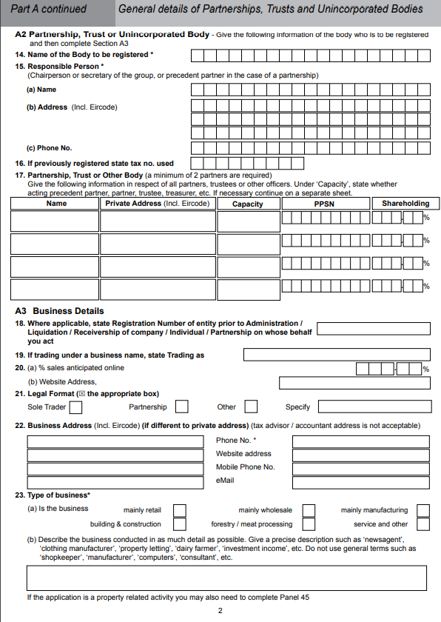
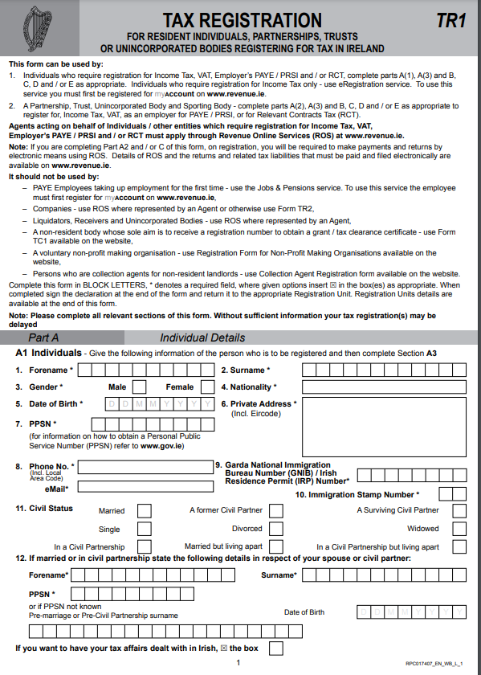
Section 6.2 –Revenue Registration TR1 Form

Slide 11
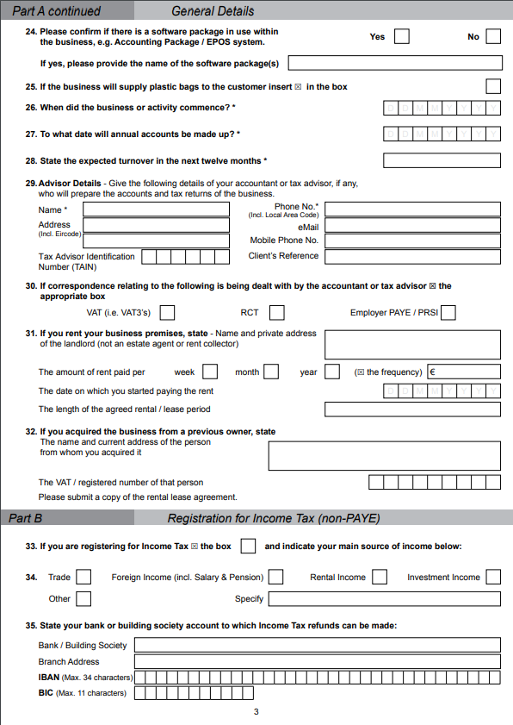
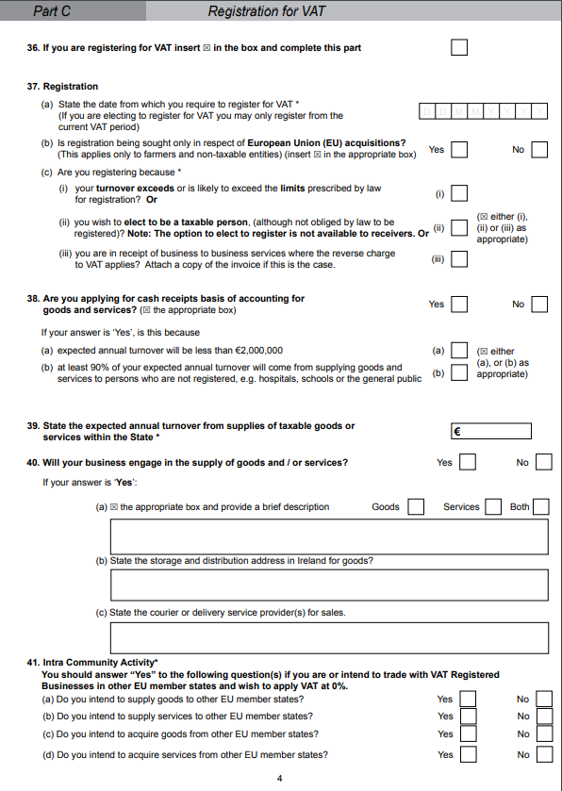
Section 6.1 –Revenue Registration TR1 Form

Slide 12
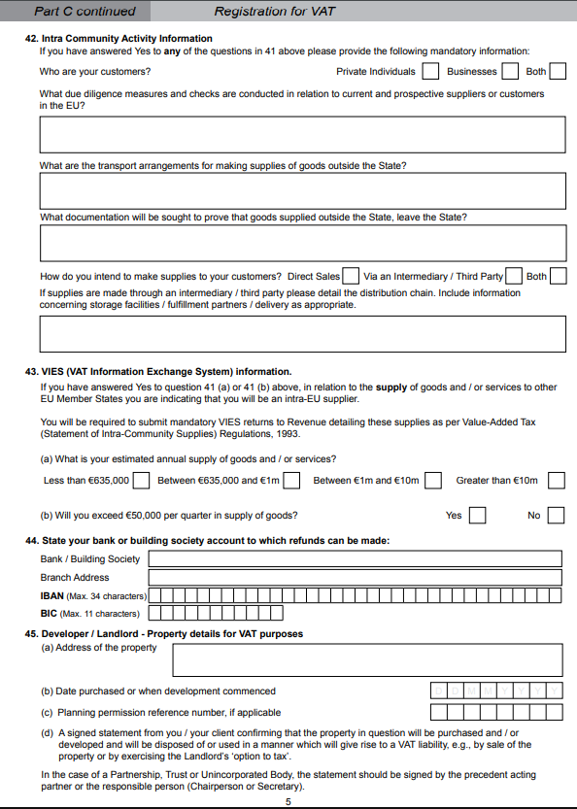
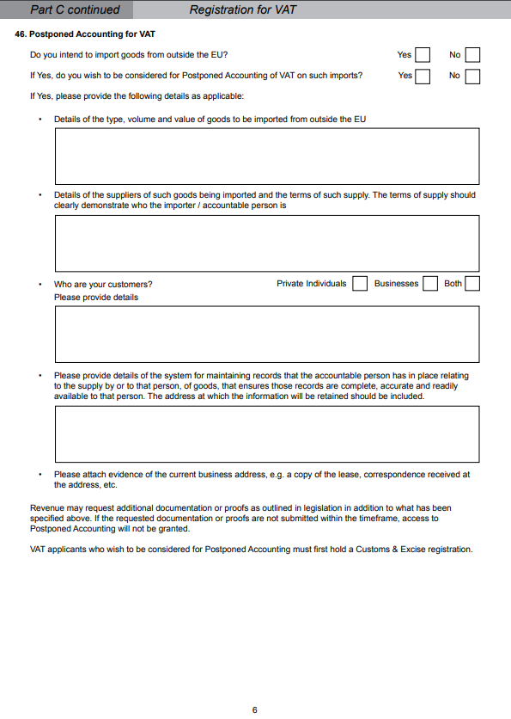
Section 6.1 –Revenue Registration TR1 Form

Slide 13
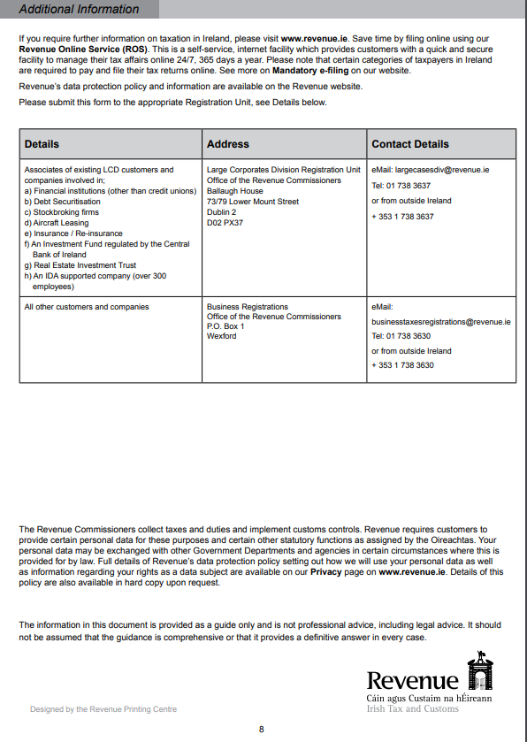
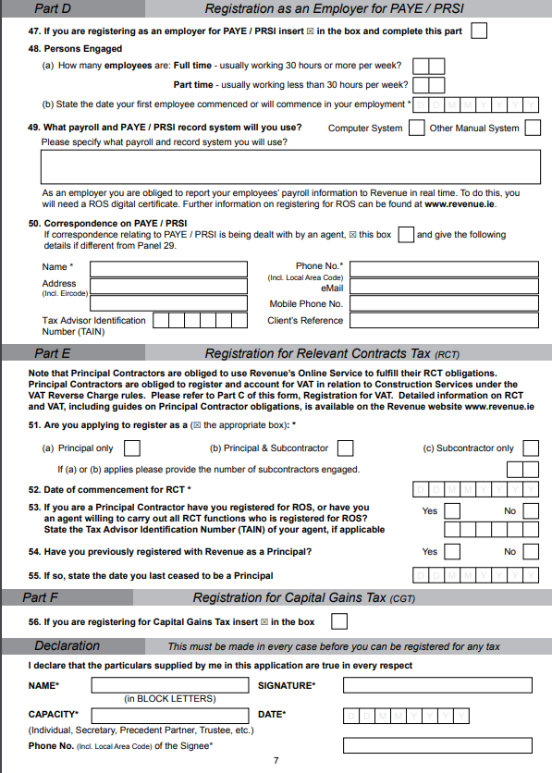
Section 6.1 –Revenue Registration TR1 Form

Slide 14
Section 6.2 –Tax Clearance Access Number
Overview
A Tax Clearance Certificate is confirmation from Revenue that your tax affairs are in order. As the applicant, both your affairs and those of connected parties to you will be assessed.
This section outlines how you can apply for a Tax Clearance Certificate.
The electronic Tax Clearance (eTC) system
The eTC system allows you to apply for a Tax Clearance Certificate online. In general, you will have to apply using:
myAccount if you are a Pay As You Earn (PAYE) customer
Revenue Online Service (ROS) if you are a business customer.
The eTC system checks your tax compliance on a regular basis. Your Tax Clearance Certificate remains valid while you are compliant. This means that there is no need for an end date on the certificate.

Slide 15
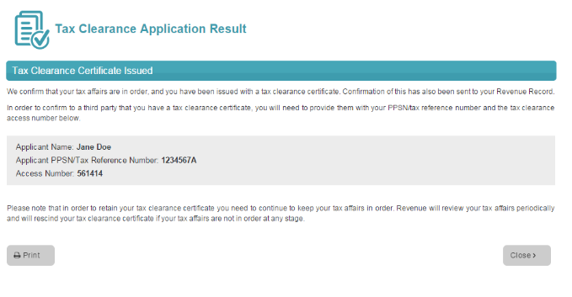
Section 6.2 –Tax Clearance Access Number
How to apply
If you have not used these services before, you register for myAccount or ROS.
See Apply for tax clearance online using eTax Clearance (eTC) for more information on how to use these services.

Slide 16
Section 6.3 –Valid Invoice
Valid Invoice
For UL Student Life C&S to classify an invoice as a Valid Invoice, the following information is required to be shown and stated on all supplier invoices.
Name and address of supplier
Supplier Vat or Tax registration number
Date of invoice
UL Student Life C&S address
UL Student Life C&S Purchase Order Number – where provided by UL Student Life C&S or its agents.
Full description of works, goods or services provided, including the address of the place with works were carried out.
Date of supply of works, goods, or services
Unit prices of works, goods, or services
Cost of works, goods, or services- excluding VAT
Vat on cost of works, goods or services – unless Reverse Charge applies
Supplier bank details
Supplier name
Name on bank account
Account number
Sort code
IBAN Number
Bank branch name and address
A valid invoice is considered to have been received by UL Student Life C&S when it is received in the following manner
Post or hand delivered to UL Student Life’s C&S registered office
Email to – lisa.ryan@ul.ie

