Slide 1


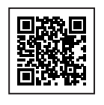

1. Create your StudentVolunteer.ie profile – scan QR code.
2. Browse and apply for volunteer opportunities.
3. Log your volunteer hours through your StudentVolunteer.ie profile.
4. Your volunteer supervisor will approve your volunteer hours.
5. Final step: to apply for your PVA – complete your reflective portfolio – on or before 25th April 2026
Contact us at: studentvolunteering@ul.ie
Volunteer Fair & PVA Ceremony 23rd October, University Concert Hall

Slide 2
