Slide 1
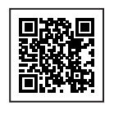
1. Create your StudentVolunteer.ie profile – scan QR code.
2. Browse and apply for volunteer opportunities.
3. Log your volunteer hours through your StudentVolunteer.ie profile.
4. Your volunteer supervisor will approve your volunteer hours.
5. Final step: to apply for your PVA – complete your reflective portfolio at pva.ul.ie on or before 25th April 2025
Contact us at: studentvolunteering@ul.ie

